Slide 1
Organizing Data & Information

Slide 2
Data & Databases
Data consists of raw facts that when organized may be transformed into information
A Database is a collection of data organized to meet users’ needs
A Database Management System (DBMS) is a group of programs that manipulate the database and provide an interface between the database & the user of the database or other application programs

Slide 3
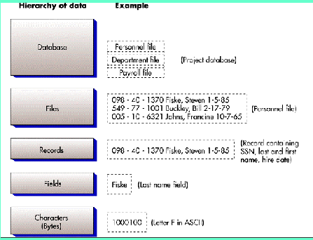
The Hierarchy of Data

Slide 4
Data Entities, Attributes, & Keys
Entity: A generalized class of people, places, or things for which data is collected, stored, & maintained for example: customers, employees
Attribute: A characteristic of an entity; something the entity is identified by e.g. customer name, employee name
Key: A field or set of fields in a record that is a unique identifier of a record e.g. Identity number, customer number

Slide 5
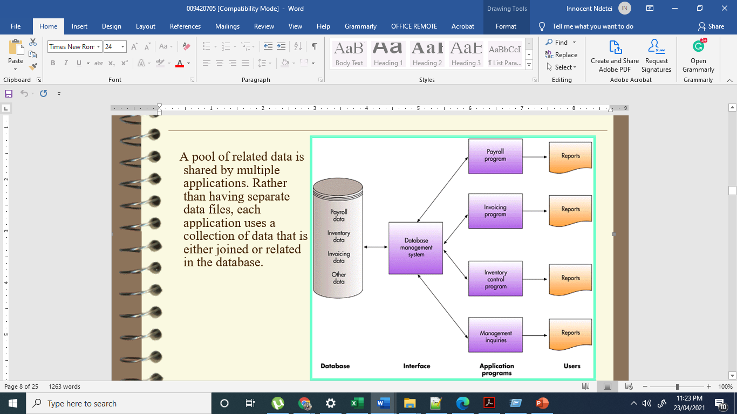
The Database Approach
A pool of related data is shared by multiple applications. Rather than having separate data files, each application uses a collection of data that is either joined or related in the database.

Slide 6
Advantages to the Database Approach
Improved strategic use of corporate data
Reduced data redundancy
Improved data integrity
Easier modification & updating
Data & program independence
Better access to data & information
Standardization of data access
A framework for program development
Better overall protection of the data
Shared data & information resources

Slide 7
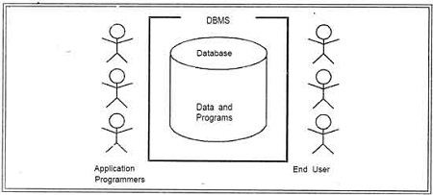
Disadvantages to the Database Approach
Relatively high cost of purchasing & operating a DBMS in a mainframe operating environment
Increased cost of specialized staff
Increased vulnerability

Slide 8
Database Design
Logical design precedes physical design
Abstract model of how data should be structured & arranged
Users should assist in creating logical design
Physical design starts with the logical design
What specific hardware/software will be used
Fine-tuning of logical design for performance/cost considerations
Planned Data Redundancy
A way of organizing data in which the logical database design is altered so that certain data entities are combined
Summary totals are carried in the data records rather than
calculated from elemental data
Some data attributes are repeated in more than one data entity to improve database performance

Slide 9
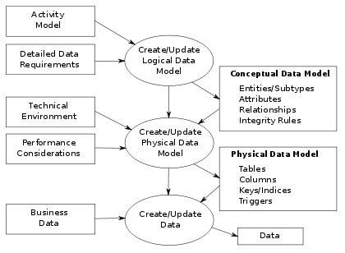
Data Modeling
Data Model
A map or diagram of entities & their relationships
Enterprise data modeling
Data modeling done at the level of the entire organization
A data model that uses basic graphical symbols to show the organization of & relationships between data

Slide 10
END

